Slide 1
West nile virus prediction
Capstone Project @ Springboard
Mentor: Alan Si
By Ruiye Ni
Mar.2016

Slide 2
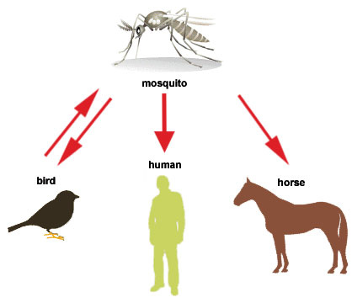
West Nile Virus
http://www.ci.berkeley.ca.us/Health_Human_Services/Environmental_Health/West_Nile_Virus.aspx

Slide 3
Datasets
Chicago Department of Public Health
Train.csv
Test.csv
Spray.csv
Weather.csv

Slide 4
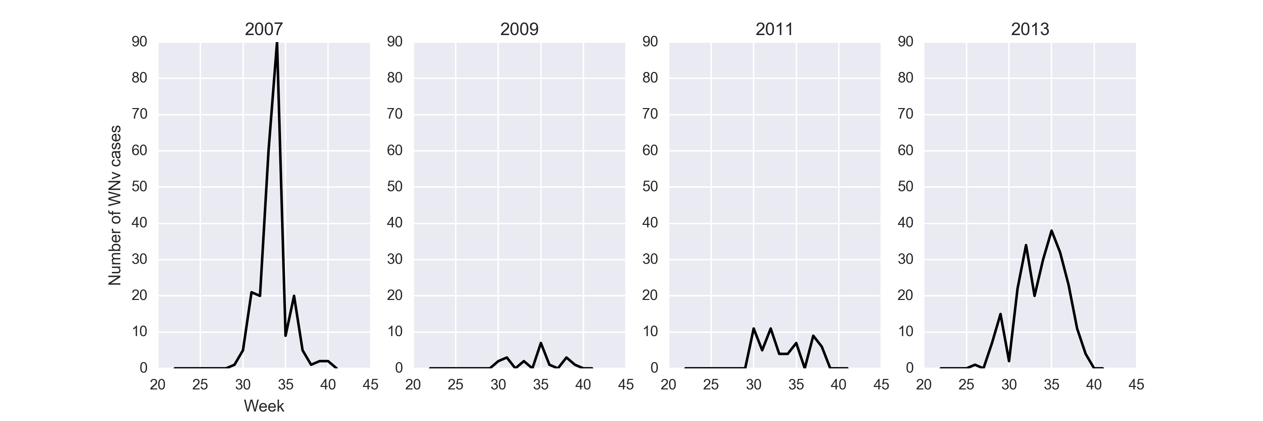
Exploratory Analysis
Yearly WN virus detection by week

Slide 5
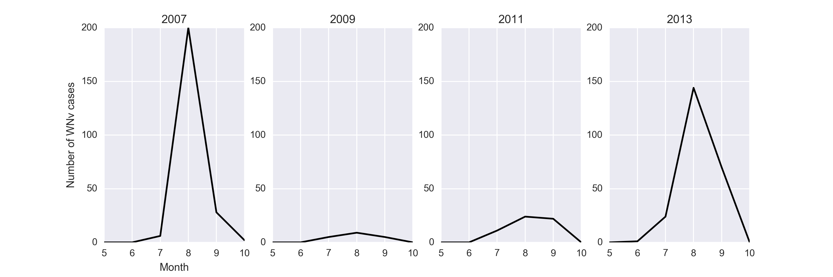
Yearly WN virus detection by month

Slide 6
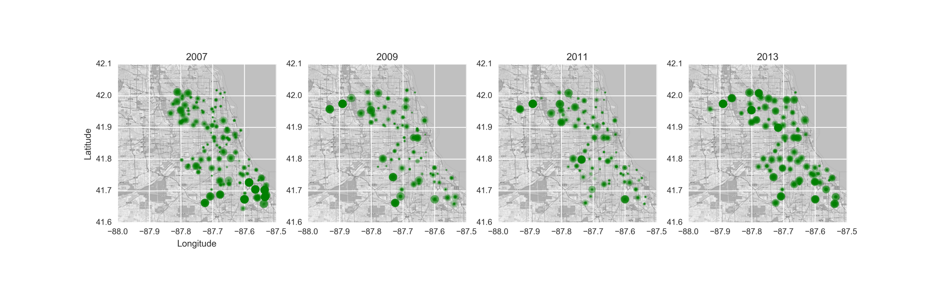
Number of mosquitos @ locations

Slide 7
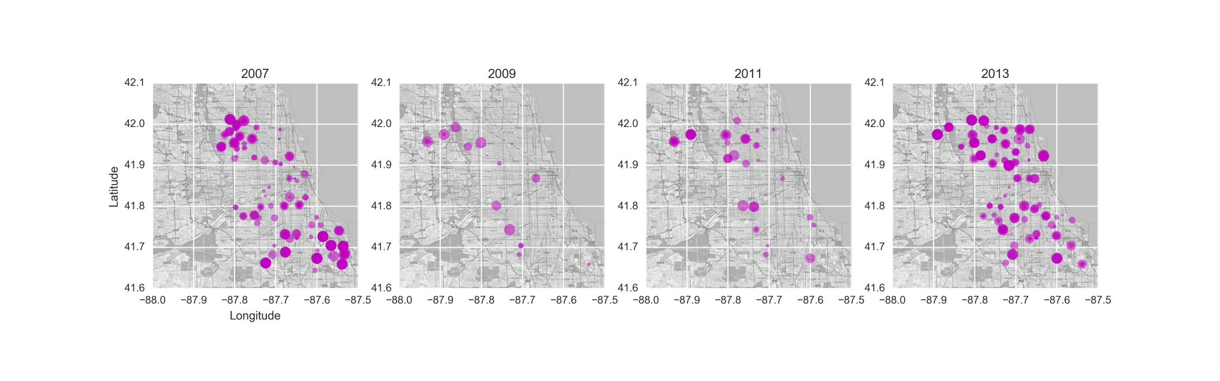
Detection of WN virus @ locations

Slide 8
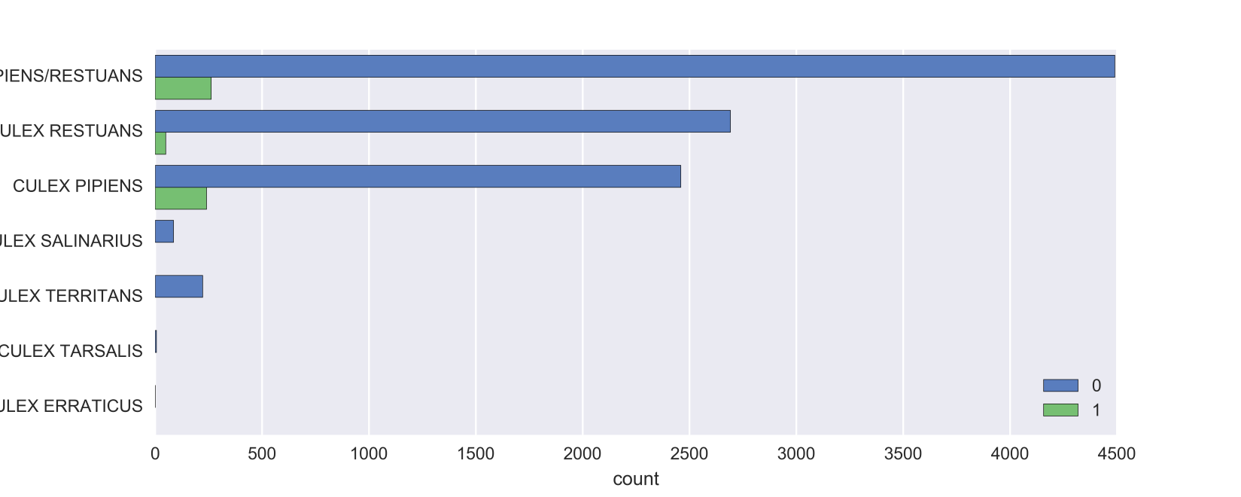
Mosquito species vs. WN virus detection

Slide 9
Predictive Model
Data cleaning and wrangling
Replace missing value with -1
Convert categorical variable into dummy variables
Data leakage
Drop predictor in the train dataset highly associated with target variable which is impossible to know in practice
Imbalanced dataset
Use precision and recall metric to evaluate model performance instead of use accuracy
Compare models
Logistic Regression

Slide 10
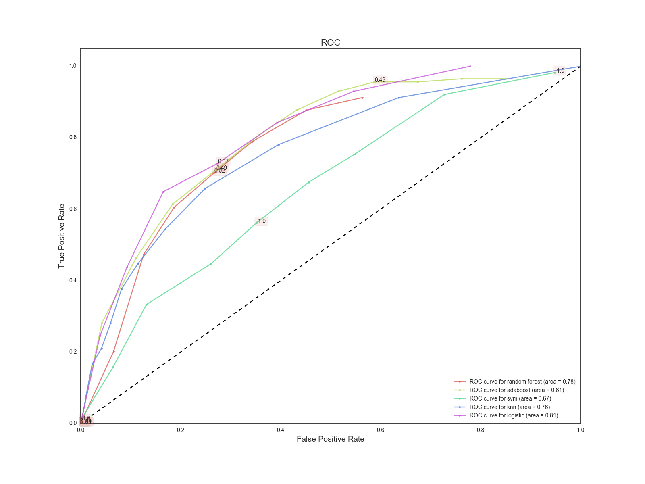
ROC Curve

Slide 11
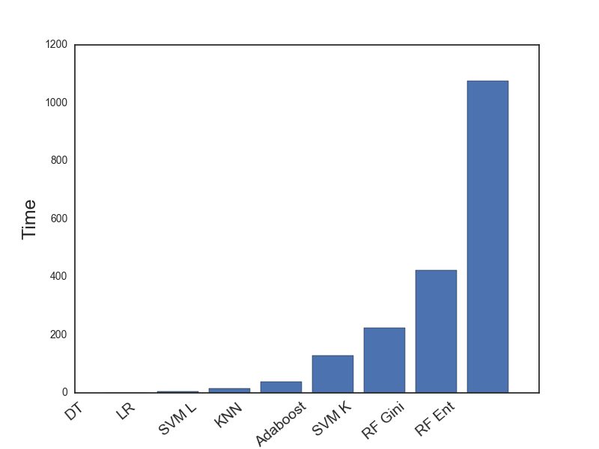
Timing

Slide 12
Prediction

